Slide 1

Grabit
Online Marketplace Website
by Group 7
Notes:
To use this title animation slide with a new image simply 1) move the top semi-transparent shape to the side, 2) delete placeholder image, 3) click on the picture icon to add a new picture, 4) Move semi-transparent shape back to original position, 5) Update text on slide.

Slide 2
Group Members: (CS331 Section 1)
1901004: Abhinandan Kumar
1901049: Ayushman Singh Chauhan
1901091: Krishnav Garg

Slide 3
PURPOSE
Due to covid times, we provide an online platform where members of IIITG family can safely buy/sell necessary products conveniently within the institute with minimal physical contact. Economically, this will lead to better utilisation of resources within college premises.

Slide 4
SCOPE
There are only verified users from IIITG which makes it a safe, reliable and efficient platform to provide goods at a discounted rate. Every Year, new students enter the institute premises which requires the need of a convenient system to promote reusability of items with added flexibility of ‘no physical contact’ shopping environment.

Slide 5
EXISTING SYSTEM
The present system focuses on sellers posting a huge number of ads on the website for buyers to have a choice to buy goods from.
The website does not directly reflect the needs of the buyer but only the seller because the existing system’s primary goal is to bring value to unwanted goods of sellers.
An online marketplace for an institute should be used to promote upkeeping of all products that can be reused, even if they are small and insignificant for the existing system. Example: Stationery, Balls, Gloves, Slippers.
No method currently available to judge the genuineness of a posted ad which leads to scamming and phishing.

Slide 6
PROPOSED SYSTEM
REGISTRATION: This platform is only for verified users; hence students and faculty must use their institute email ids to keep the platform secure.
TWO SECTIONS FOR ADS: One section for sellers to post ads and one for buyers to post ads to provide a better experience for buyers’ needs.
SECURITY: Quality of Life features like inbuilt chatting system to avoid the necessity of sharing mobile numbers and maintaining users’ confidentiality.
CATEGORIES: Several Categories like Electronics, Stationery etc have been added that can be used as ‘Tags’ for ads.
DASHBOARD: If a person wants to sell a product, they’ll have their dashboard, which has a record of their previous and current ads; they can edit them according to their requirement
SEARCH BAR: To look for a particular product, we provide them with various filter options to specify their exact requirements.
LIKING SYSTEM: Users can upvote and downvote an ad to help keep a tally of their genuineness according to the community for better recommendation of ads.

Slide 7
ADVANTAGES
More Secure for users because profiles are linked only to institute email ID.
Promotes Sale of Small Products by giving buyers the power to post ads which leads to efficient reusability.
Better Ad management by using the liking and ad verification system along with auto cooldown system where old ads get taken down.
Zero shipping cost/tax of any sort, as the transaction, happens within the campus.

Slide 8
FUNCTIONAL REQUIREMENTS
All the products will be listed to be viewed in the form of cards displaying the picture, price, short description, days posted ago.
Users will be able to choose between the categories of the products listed via the category bar.
Users will be able to search for products via the search bar.
To become a seller/buyer, the user will be able to sign up with an email registered with the college.
The user must provide name, roll number, room number, phone number, registered email address, photo, and password during the signup up process.
Registered users will be able to upload ads for their products via a form having inputs for title, category, description, price,and photos.
Registered users will be able to view, edit, delete all their listed product ads in a dashboard.
Users can downvote ads that seem fake to them or upvote deals that seem good to them, this can help the community significantly.
A user can report an ad using help section to contact the admins if they find something suspicious or fake.
Users can chat with others to bargain or ask for personal details like Room number, once the deal is made.

Slide 9
NON-FUNCTIONAL REQUIREMENTS
24*7 Availability of the website(after hosting)
Attractive and Simple UI – Highly User Friendly.
A method to directly contact the Admin.

Slide 10




SOFTWARE TOOLS USED:
Backend:
Database:
Front-End

Slide 11
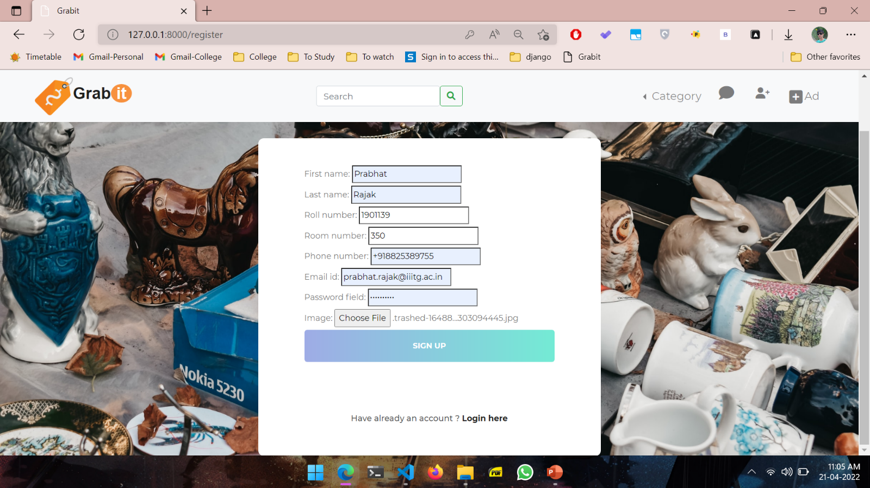
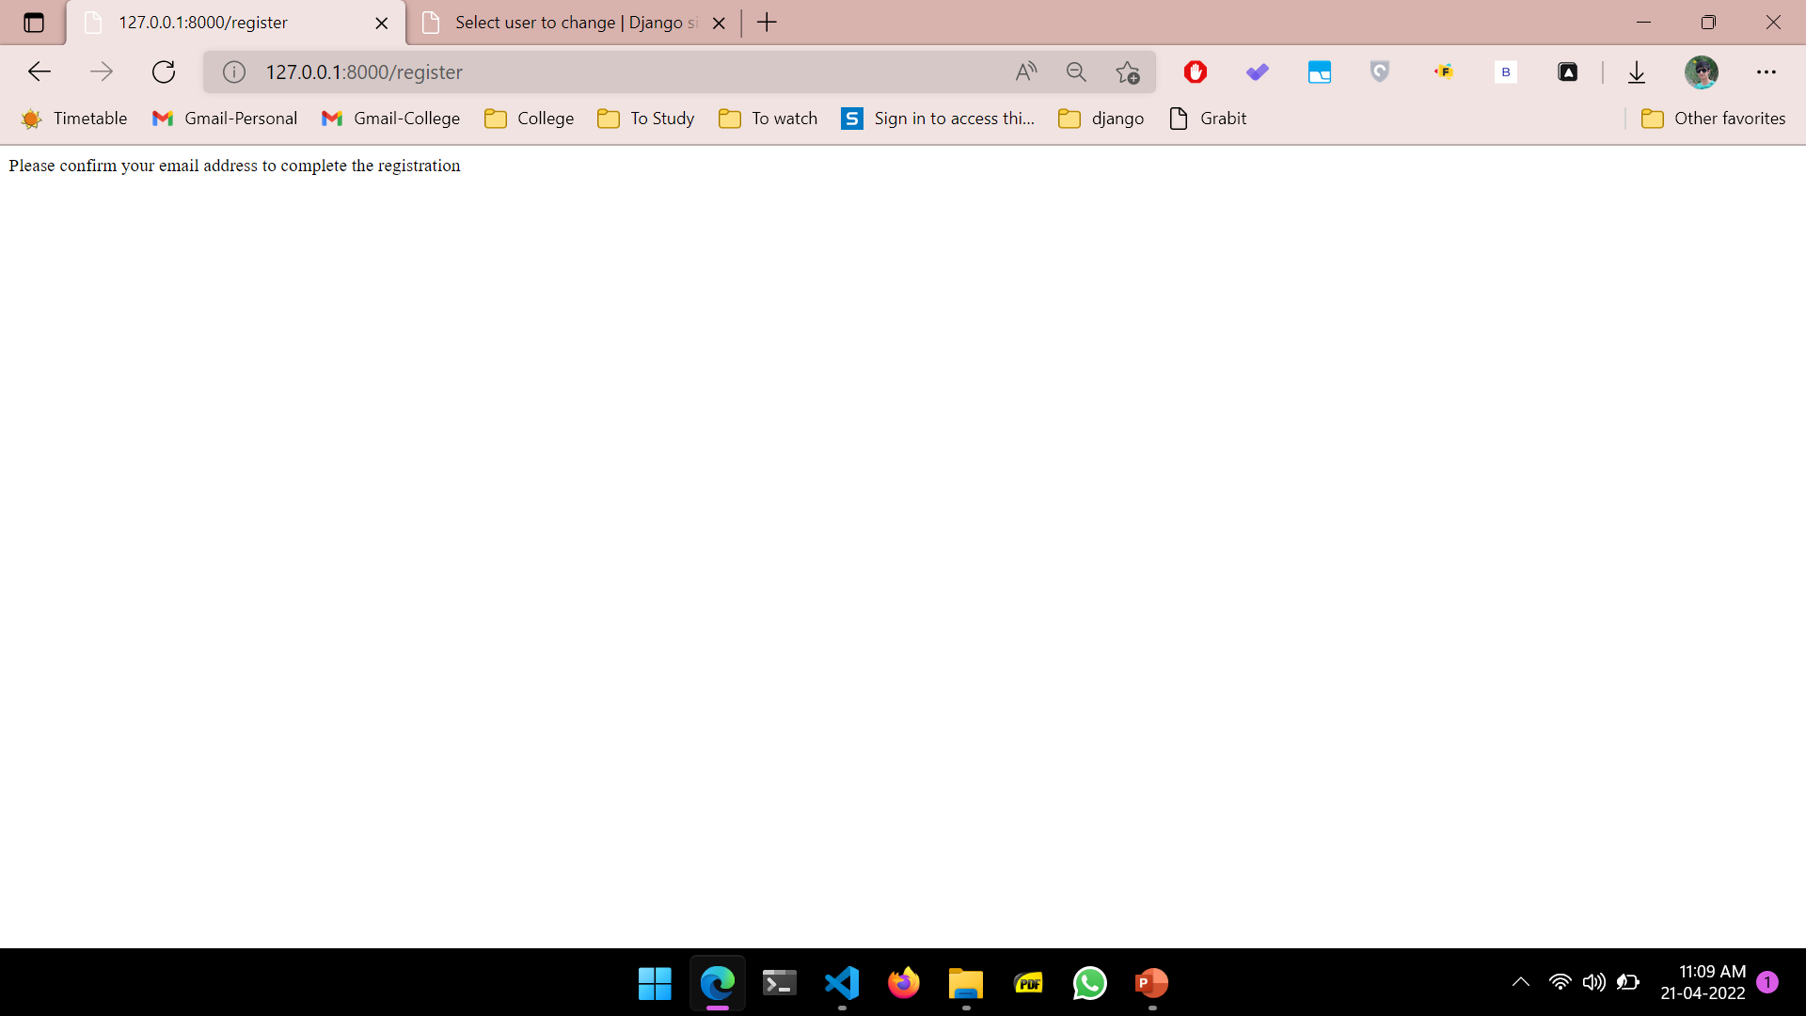
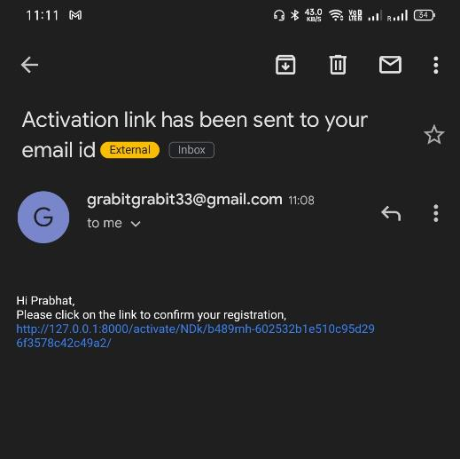
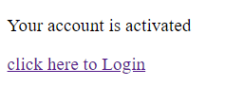
1
REGISTER
First user needs to register using iiitg email only. After confirming the email via verification , the account is activated.

Slide 12
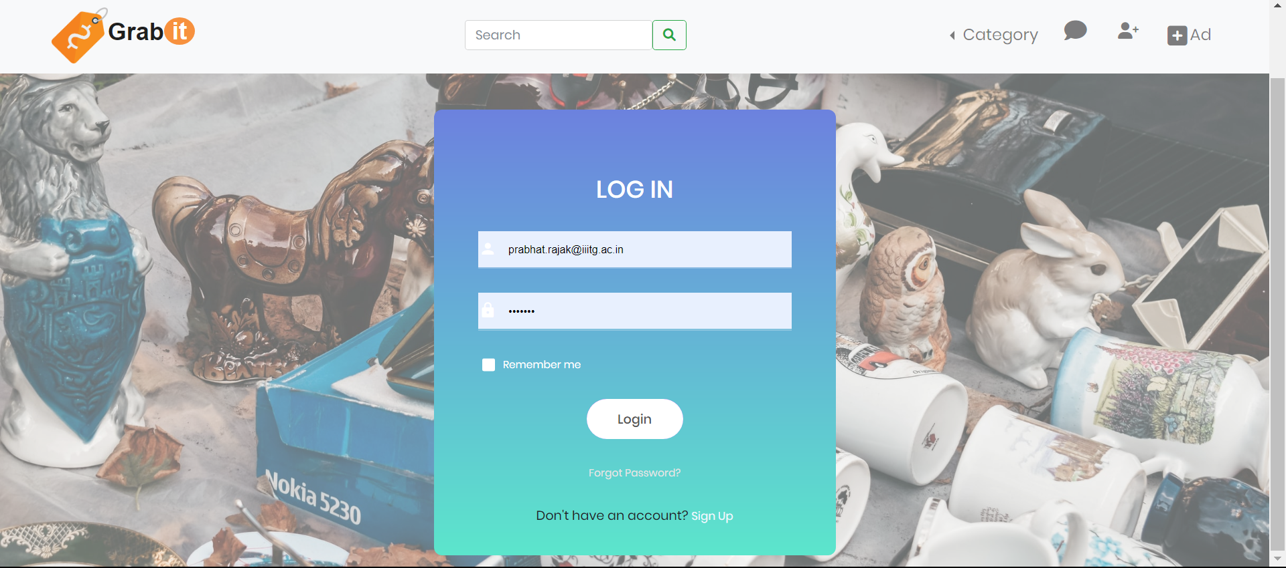
2
LOGIN
This page enables user to login easily. Incase user has no account, they can choose to signup.

Slide 13
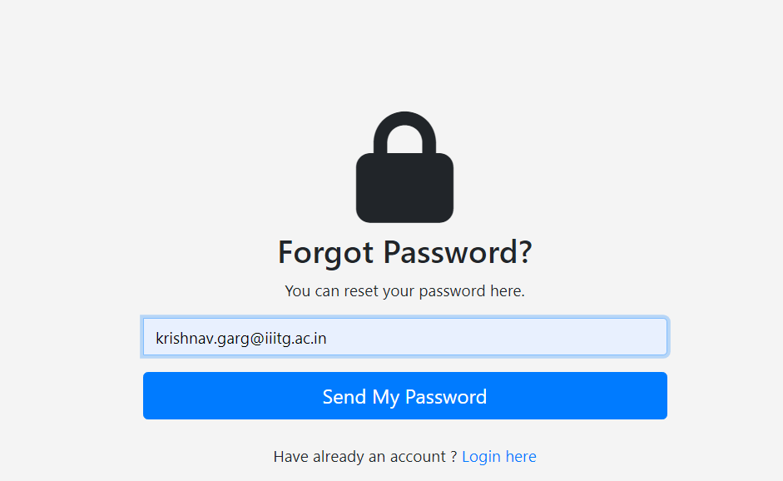
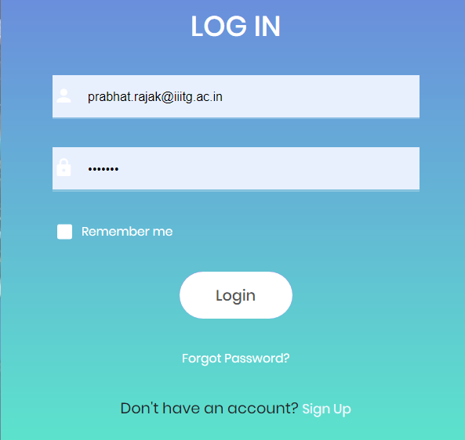
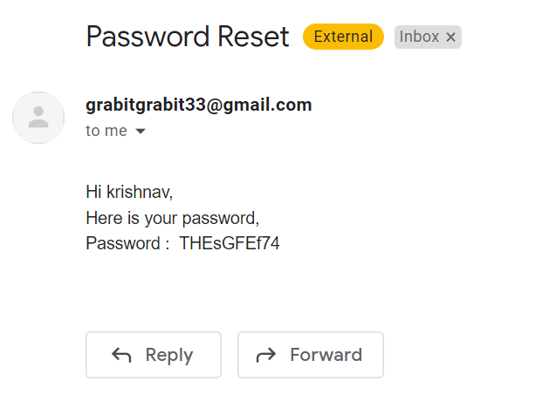
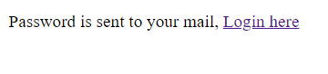
3
FORGOT PASSWORD
If user forgets password , then they can receive a randomly generated temporary password on their email id.
They can login using that password and change it afterwards if needed.

Slide 14
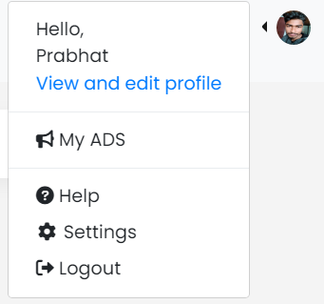
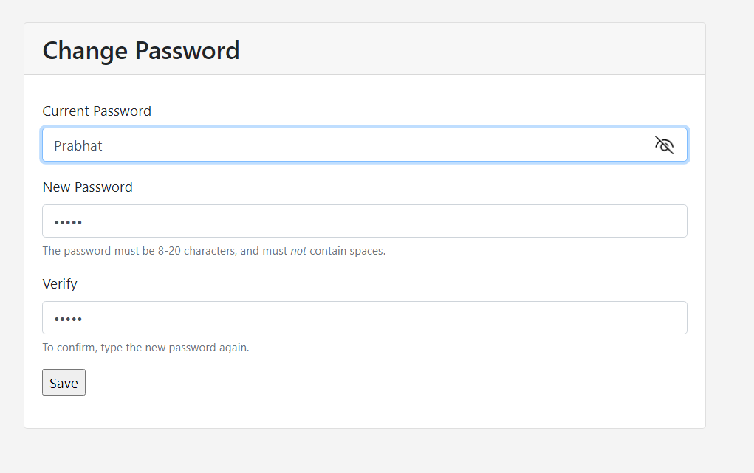
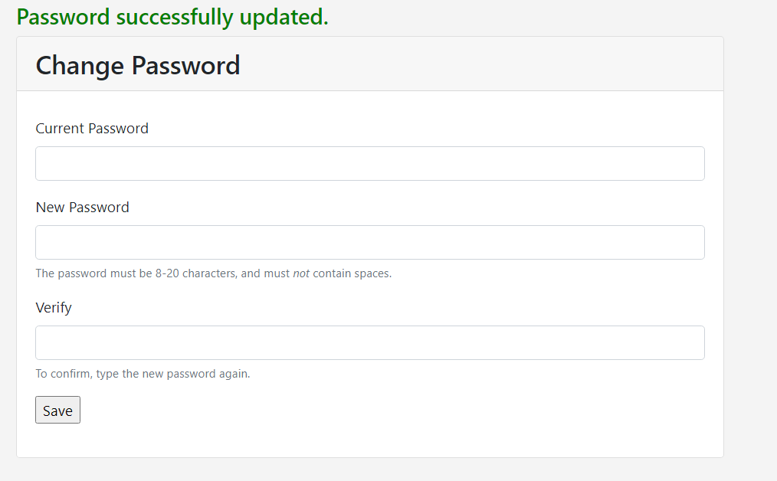
4
CHANGE PASSWORD
To change password, user must go to settings, then enter old and new passwords. Hitting save will change password successfully.

Slide 15
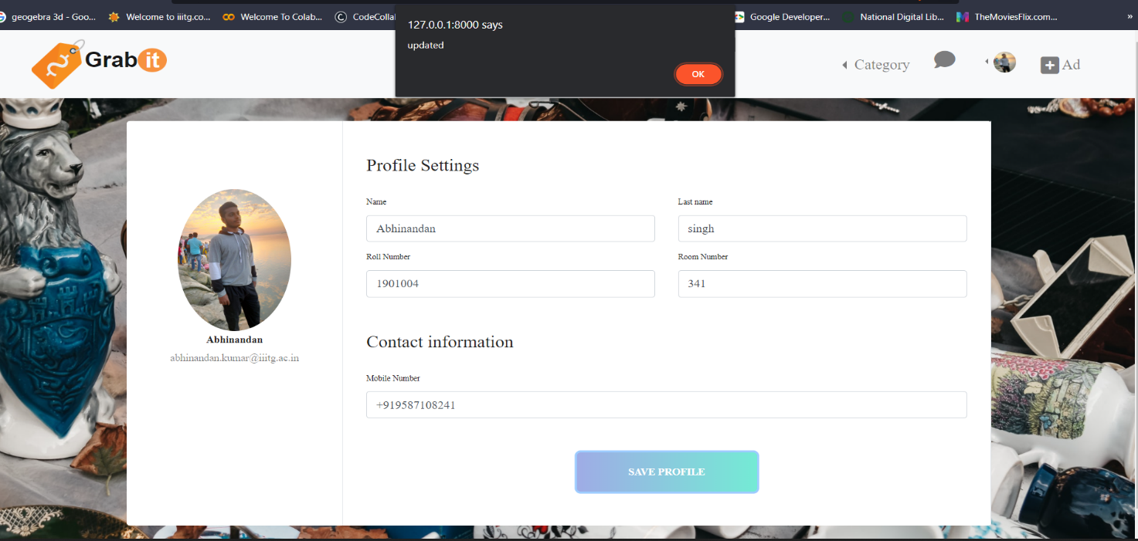
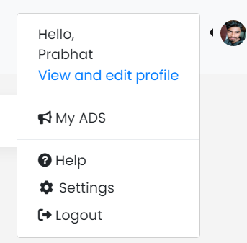
5
VIEW AND EDIT PROFILE
User can see and change their profile details via this form. On clicking save, an alert pops up showing success.

Slide 16
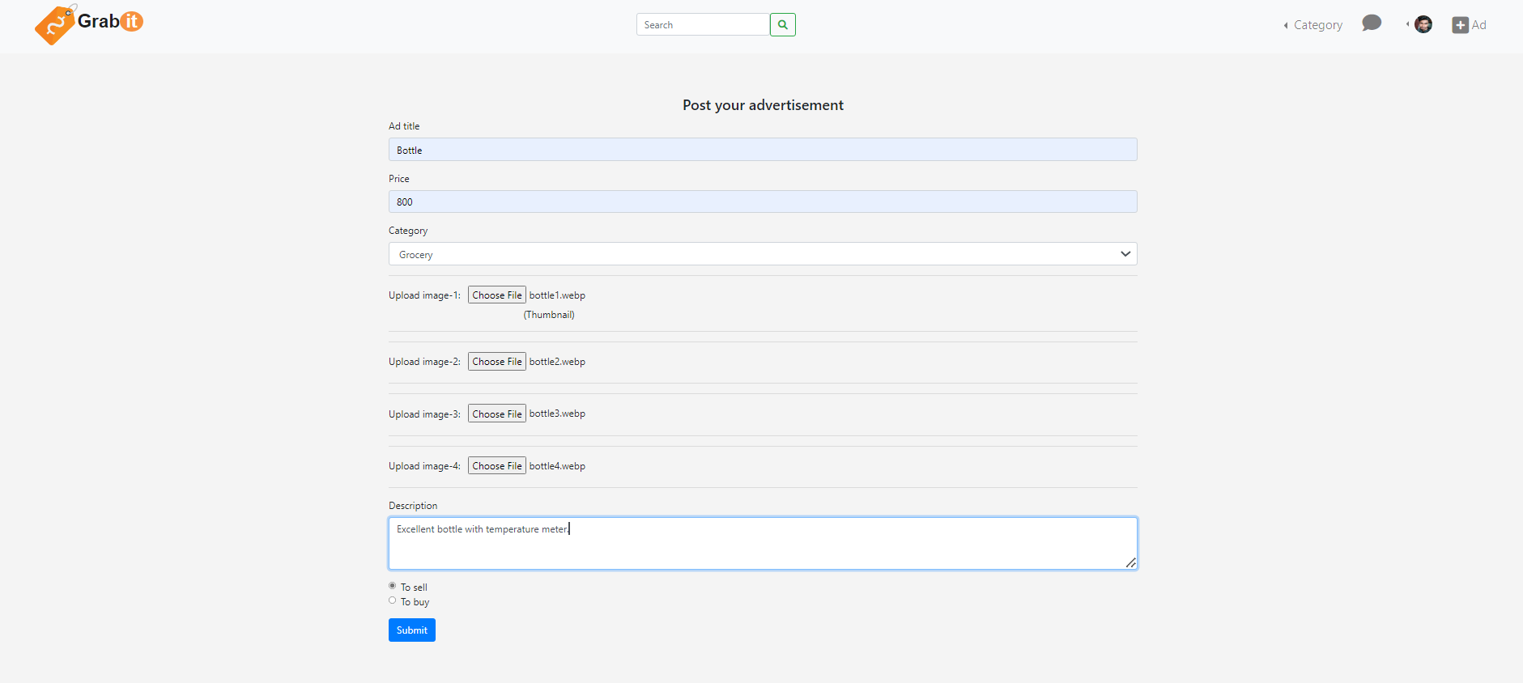
6
ADD PRODUCT
User can easily post ad with attributes like title ,images ,description and prices.
Note that user can mention where this ad is :’To buy’ or ‘To sell’. Hence, they can request for products they want using ‘To buy’ option.

Slide 17
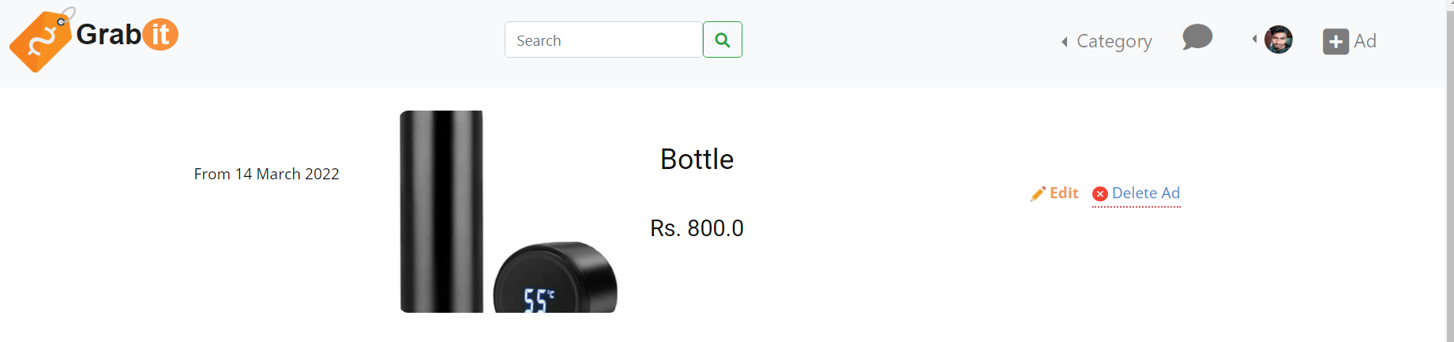
7
My ads
Get your facts straight with 5 W’s
Users can see, edit and delete their already posted ads from this page

Slide 18
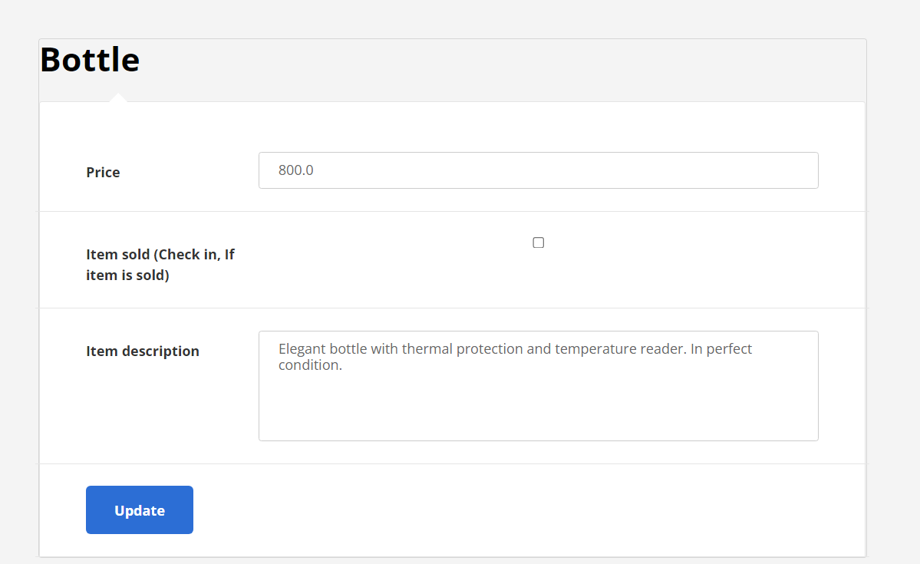
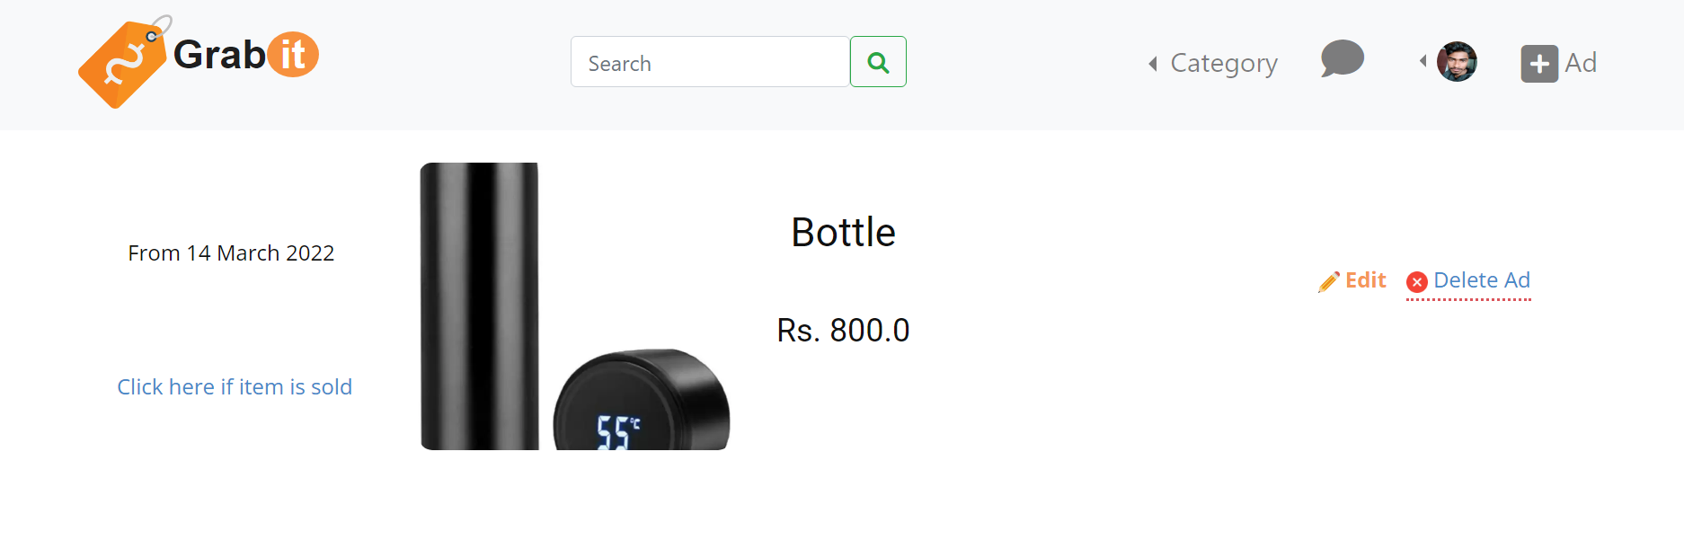
8
Edit ads
Via edit ad option, users can update price and description of their previous ads.
Sellers can also mark their item as sold after the deal is made so that their ad gets removed from the ads list.

Slide 19
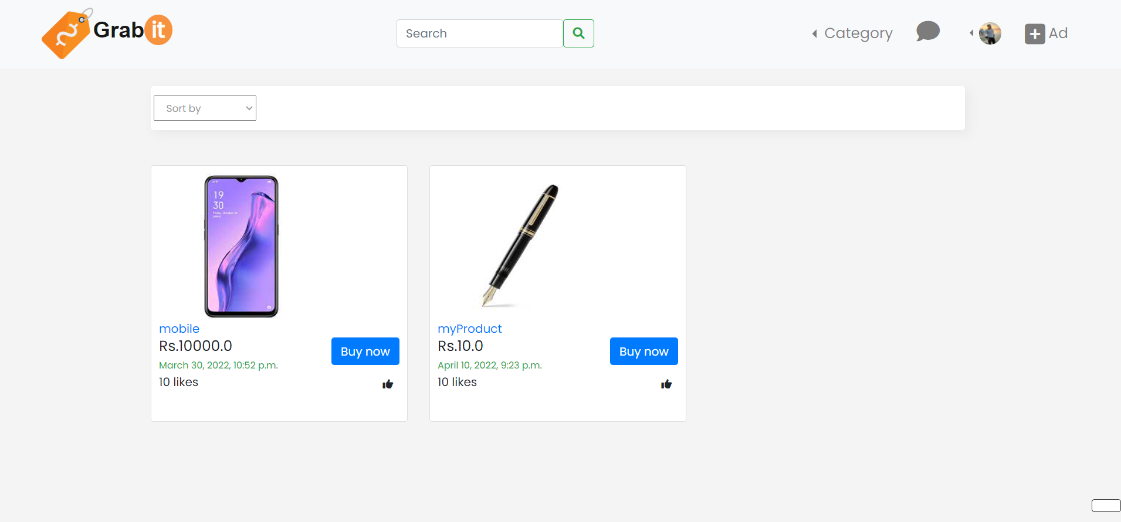
9
Homepage
This is the homepage where all the sellers ads are displayed in card format with details like : date , title, likes, and price. Click on the card/buy now option to open product page.
Page numbers are displayed below for better navigation; Sort by option available for sorting products.
Category dropdown enables you to see product by their types; It also enables you to see ads from buyers.

Slide 20
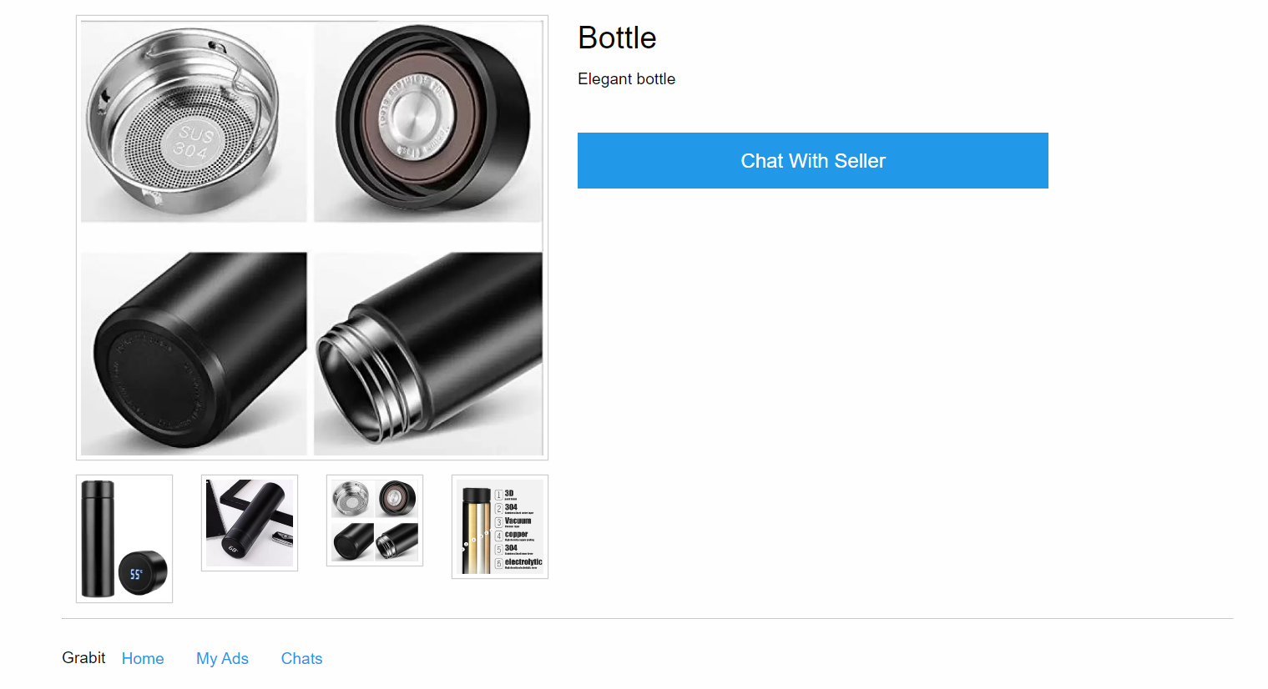
10
Product page
Products and its details and images are shown here. User can click on images one by one to enlarge them.
Chat with seller option is provided if you want to continue the deal.

Slide 21
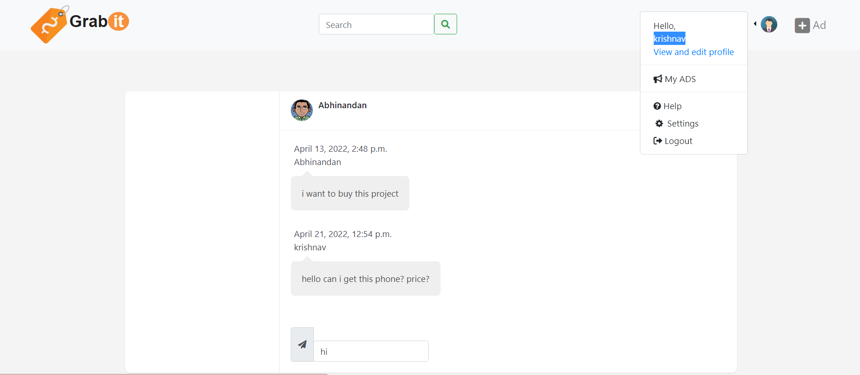
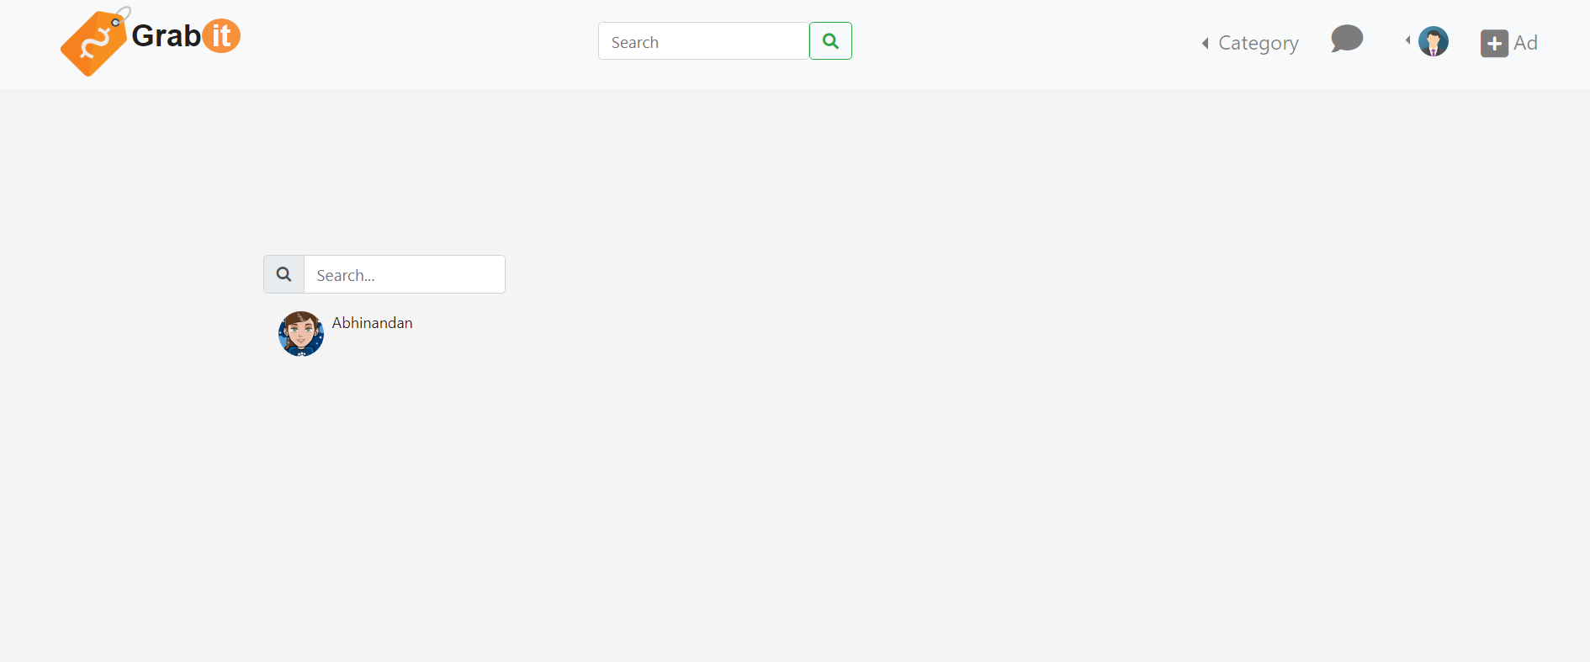
11
chat
1.After using chat with seller option. You get a chat window to talk to the user.
2. After clicking on chat icon from navbar, all your active chats get displayed for easy access.

Slide 22
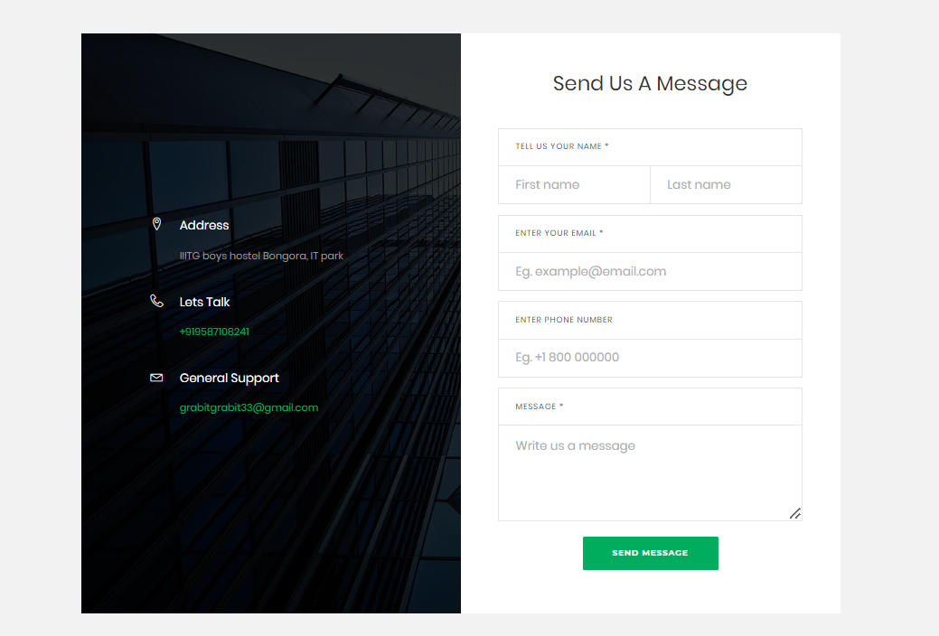
12
Help page
User can contact admin via email and phone number in case they want to report an issue.
Emailing option within the website is provided to directly send message to admin.

Slide 23
CONTRIBUTIONS:
Abhinandan Kumar:
Backend:-
Registration + Chat + Login +Homepage(Category + Sorting etc.)+Product Page
Frontend & Backend:-
Help + Change Password+ Forgot Password
Model and Views formation in Django
ERD + SRS

Slide 24
CONTRIBUTIONS:
Ayushman Singh Chauhan:
Frontend:-
Registration + Chat
Frontend & Backend:-
Ad Product Page + View and Edit Profile
Testing
DFD + Use Case Diagram + SRS

Slide 25
CONTRIBUTIONS:
Krishnav Garg:
Frontend:-
Product + Login + My ads
Frontend & Backend:-
Homepage + Edit Ads
ERD + PPT + SRS

Slide 26
That’s All!
THANK YOU
Github Link

